Slide 1
Chapter 7
How to handle exceptions and validate data

Slide 2
Objectives (part 1)
Applied
Given a form that uses text boxes to accept data from the user, write code that catches any exceptions that might occur.
Given a form that uses text boxes to accept data and the validation specifications for that data, write code that validates the user entries.
Use dialog boxes as needed within your applications.
Knowledge
Explain what an exception is and what it means for an exception to be thrown and handled.
Describe the Exception hierarchy and name two of its subclasses.
Describe the use of try-catch statements to catch specific exceptions as well as all exceptions.

Slide 3
Objectives (part 2)
Describe the use of the properties and methods of an exception object.
Describe the use of throw statements.
Describe the three types of data validation that you’re most likely to perform on a user entry.
Describe two ways that you can use generic validation methods in a method that validates all of the user entries for a form.

Slide 4
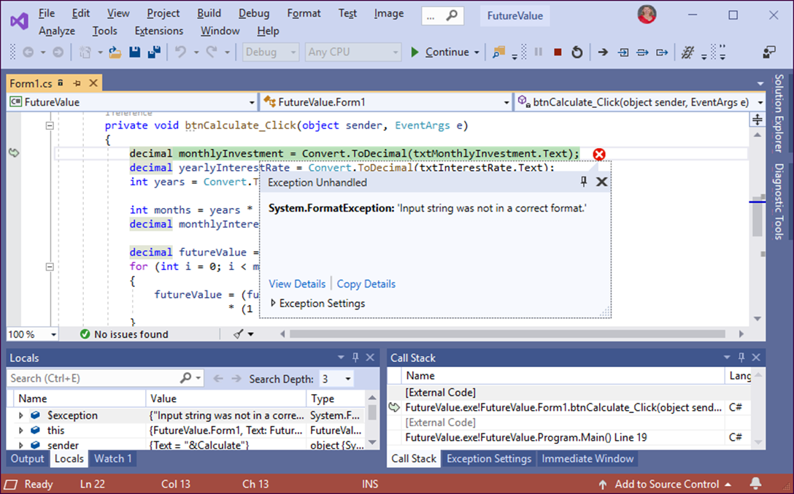
The dialog box for an unhandled exception

Slide 5
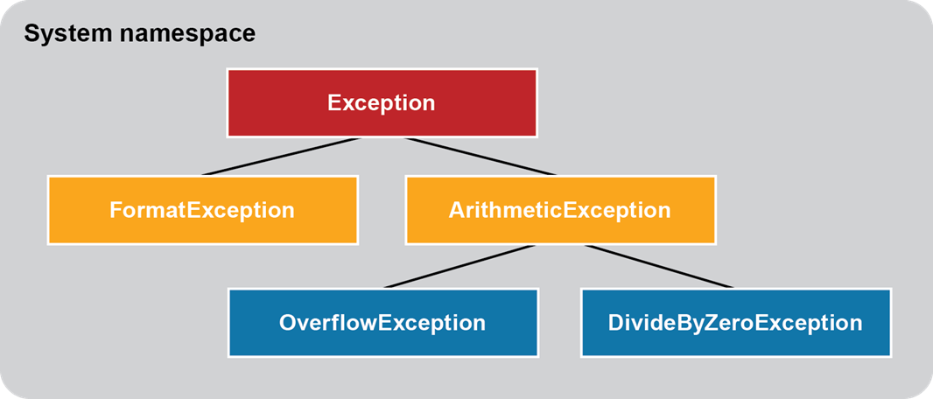
The Exception hierarchy for five common exceptions

Slide 6
Methods that might throw exceptions
Class Method Exception
Convert ToDecimal(string) FormatException OverflowException
Convert ToInt32(string) FormatException OverflowException
Decimal Parse(string) FormatException OverflowException
DateTime Parse(string) FormatException

Slide 7
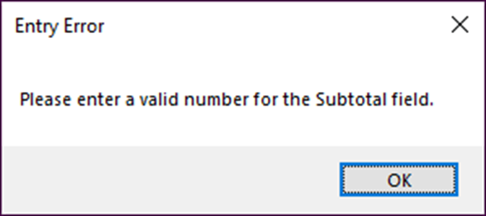
The syntax to display a dialog box with an OK button
MessageBox.Show(text[, caption]);
A dialog box with an OK button
The statement that displays this dialog box
MessageBox.Show(
"Please enter a valid number for the Subtotal field.",
"Entry Error");

Slide 8
The syntax for a simple try-catch statement
try { statements }
catch { statements }
A try-catch statement
try
{
decimal subtotal = Convert.ToDecimal(txtSubtotal.Text);
decimal discountPercent = .2m;
decimal discountAmount = subtotal * discountPercent;
decimal invoiceTotal = subtotal - discountAmount;
}
catch
{
MessageBox.Show(
"Please enter a valid number for the Subtotal field.",
"Entry Error");
}

Slide 9
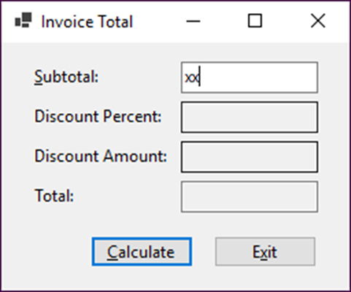
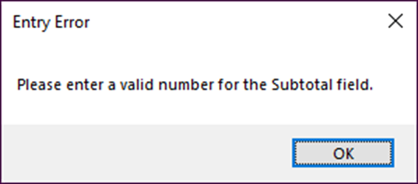
The dialog box that’s displayed for an invalid subtotal

Slide 10
The syntax for a try-catch statement that accesses the exception
try { statements }
catch(ExceptionClass exceptionName) { statements }
Two common properties for all exceptions
Property Description
Message Gets a message that briefly describes the current exception.
StackTrace Gets a string that lists the methods that were called before the exception occurred.
A common method for all exceptions
Method Description
GetType() Gets the type of the current exception.

Slide 11
A try-catch statement that accesses the exception
try
{
decimal subtotal =
Convert.ToDecimal(txtSubtotal.Text);
}
catch(Exception ex)
{
MessageBox.Show(ex.Message + "\n\n" +
ex.GetType().ToString() + "\n" +
ex.StackTrace, "Exception");
}

Slide 12
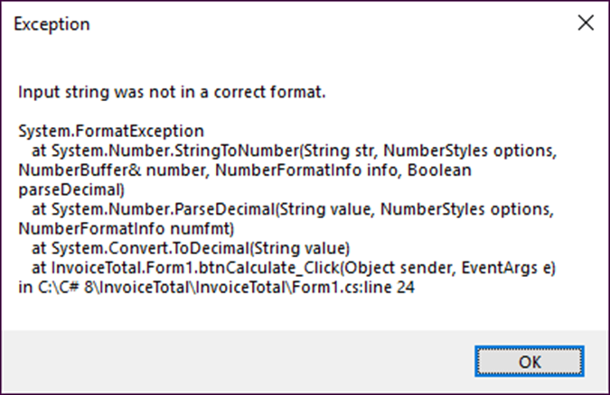
The dialog box that’s displayed for the exception

Slide 13
The syntax for a try-catch statement that catches specific types of exceptions
try { statements }
[catch(MostSpecificException [exceptionName]) { statements }]...
[catch(NextMostSpecificException [exceptionName]) { statements }]...
[catch([LeastSpecificException [exceptionName]]) { statements }]
[finally { statements }]

Slide 14
A statement that catches two specific exceptions
try
{
decimal monthlyInvestment =
Convert.ToDecimal(txtMonthlyInvestment.Text);
decimal yearlyInterestRate =
Convert.ToDecimal(txtInterestRate.Text);
int years = Convert.ToInt32(txtYears.Text);
}
catch(FormatException) // a specific exception
{
MessageBox.Show(
"A format exception has occurred. Please check all entries.",
"Entry Error");
}
catch(OverflowException) // another specific exception
{
MessageBox.Show(
"An overflow exception has occurred. Please enter smaller values.",
"Entry Error");
}
catch(Exception ex) // all other exceptions
{
MessageBox.Show(ex.Message, ex.GetType().ToString());
}
finally // this code runs whether or not an exception occurs
{
PerformCleanup();
}

Slide 15
The syntax for throwing a new exception
throw new ExceptionClass([message]);
The syntax for throwing an existing exception
throw exceptionName;
When to throw an exception
When a method encounters a situation where it isn’t able to complete its task.
When you want to generate an exception to test an exception handler.
When you want to catch the exception, perform some processing, and then throw the exception again.

Slide 16
A method that throws an exception when an exceptional condition occurs
private decimal CalculateFutureValue(
decimal monthlyInvestment,
decimal monthlyInterestRate, int months)
{
if (monthlyInvestment <= 0)
throw new Exception(
"Monthly Investment must be greater than 0.");
if (monthlyInterestRate <= 0)
throw new Exception(
"Interest Rate must be greater than 0.");
...
}

Slide 17
Code that throws an exception for testing
try
{
decimal subtotal =
Convert.ToDecimal(txtSubtotal.Text);
throw new Exception(
"An unknown exception occurred.");
}
catch (Exception ex)
{
MessageBox.Show(ex.Message + "\n\n"
+ ex.GetType().ToString() + "\n"
+ ex.StackTrace, "Exception");
}

Slide 18
Code that rethrows an exception
try
{
Convert.ToDecimal(txtSubtotal.Text);
}
catch (FormatException fe) {
txtSubtotal.Focus();
throw fe;
}

Slide 19
Code that uses a throw expression to throw an exception (C# 7.0 or later)
string? productCode = null;
string code = productCode ?? throw new Exception(
"Code cannot be null.");

Slide 20
The code for the Future Value application with exception handling (part 1)
private void btnCalculate_Click(object sender, EventArgs e)
{
try
{
decimal monthlyInvestment =
Convert.ToDecimal(txtMonthlyInvestment.Text);
decimal yearlyInterestRate =
Convert.ToDecimal(txtInterestRate.Text);
int years = Convert.ToInt32(txtYears.Text);
decimal monthlyInterestRate = yearlyInterestRate / 12 / 100;
int months = years * 12;
decimal futureValue = this.CalculateFutureValue(
monthlyInvestment, monthlyInterestRate, months);
txtFutureValue.Text = futureValue.ToString("c");
txtMonthlyInvestment.Focus();
}

Slide 21
The code for the Future Value application with exception handling (part 2)
catch(FormatException)
{
MessageBox.Show(
"Invalid numeric format. Please check all entries.",
"Entry Error");
}
catch(OverflowException)
{
MessageBox.Show(
"Overflow error. Please enter smaller values.",
"Entry Error");
}
catch(Exception ex)
{
MessageBox.Show(
ex.Message,
ex.GetType().ToString());
}
}

Slide 22
The code for the Future Value application with exception handling (part 3)
private decimal CalculateFutureValue(decimal monthlyInvestment,
decimal monthlyInterestRate, int months)
{
decimal futureValue = 0m;
for (int i = 0; i < months; i++)
{
futureValue = (futureValue + monthlyInvestment)
* (1 + monthlyInterestRate);
}
return futureValue;
}

Slide 23
Code that checks that an entry has been made
if (txtMonthlyInvestment.Text == "")
{
MessageBox.Show(
"Monthly Investment is a required field.",
"Entry Error");
txtMonthlyInvestment.Focus();
}
Code that checks an entry for a valid decimal value
if (!(Decimal.TryParse(txtMonthlyInvestment.Text, out _)))
{
MessageBox.Show(
"Monthly Investment must be a valid decimal value.",
"Entry Error");
txtMonthlyInvestment.Focus();
}

Slide 24
Code that checks an entry for a valid range
decimal monthlyInvestment =
Convert.ToDecimal(txtMonthlyInvestment.Text);
if (monthlyInvestment <= 0)
{
MessageBox.Show(
"Monthly Investment must be greater than 0.",
"Entry Error");
txtMonthlyInvestment.Focus();
}
else if (monthlyInvestment >= 1000)
{
MessageBox.Show(
"Monthly Investment must be less than 1,000.",
"Entry Error");
txtMonthlyInvestment.Focus();
}

Slide 25
A method that checks for a required field
private string IsPresent(string value, string name)
{
string msg = "";
if (value == "")
{
msg += name + " is a required field.\n";
}
return msg;
}

Slide 26
A method that checks for a valid numeric format
private string IsDecimal(string value, string name)
{
string msg = "";
if (!Decimal.TryParse(value, out _))
{
msg += name +
" must be a valid decimal value.\n";
}
return msg;
}

Slide 27
A method that checks for a valid numeric range
private string IsWithinRange(string value, string name, decimal min, decimal max)
{
string msg = "";
if (Decimal.TryParse(value, out decimal number))
{
if (number < min || number > max)
{
msg += name + " must be between " +
min + " and " + max + ".\n";
}
}
return msg;
}

Slide 28
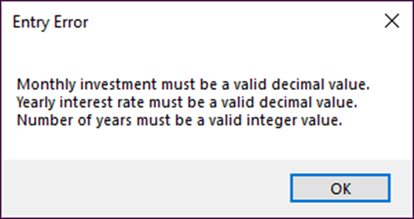
A dialog box that displays three error messages

Slide 29
Code that validates multiple entries (part 1)
private bool IsValidData()
{
bool success = true;
string errorMessage = "";
// Validate the Monthly Investment text box
errorMessage += IsDecimal(txtMonthlyInvestment.Text,
txtMonthlyInvestment.Tag.ToString());
errorMessage += IsWithinRange(txtMonthlyInvestment.Text,
txtMonthlyInvestment.Tag.ToString(),
1, 1000);
// Validate the Yearly Interest Rate text box
errorMessage += IsDecimal(txtInterestRate.Text,
txtInterestRate.Tag.ToString());
errorMessage += IsWithinRange(txtInterestRate.Text,
txtInterestRate.Tag.ToString(), 1, 20);

Slide 30
Code that validates multiple entries (part 2)
// Validate the Number of Years text box
errorMessage += IsInt32(txtYears.Text,
txtYears.Tag.ToString());
errorMessage += IsWithinRange(txtYears.Text,
txtYears.Tag.ToString(), 1, 40);
if (errorMessage != "")
{
success = false;
MessageBox.Show(errorMessage, "Entry Error");
}
return success;
}

Slide 31
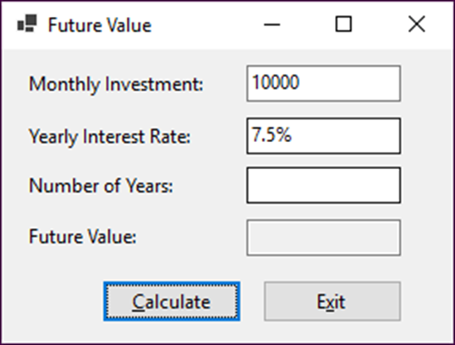
The Future Value form with three invalid fields

Slide 32
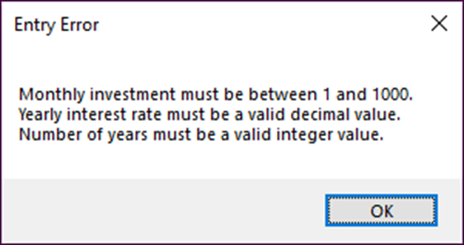
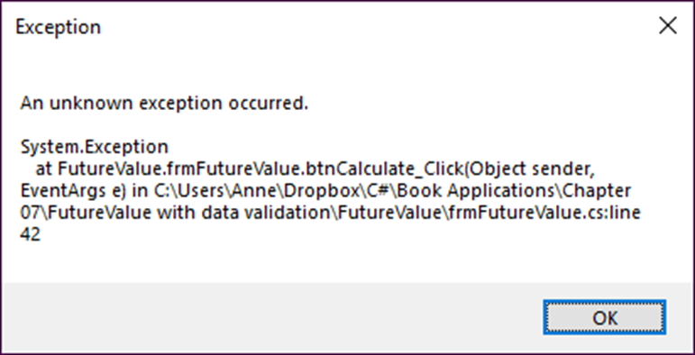
The dialog box that displays the errors
The dialog box for an unanticipated exception

Slide 33
The code for the Future Value application (part 1)
private void btnCalculate_Click(object sender, EventArgs e)
{
try
{
if (IsValidData())
{
decimal monthlyInvestment =
Convert.ToDecimal(txtMonthlyInvestment.Text);
decimal yearlyInterestRate =
Convert.ToDecimal(txtInterestRate.Text);
int years = Convert.ToInt32(txtYears.Text);
int months = years * 12;
decimal monthlyInterestRate = yearlyInterestRate / 12 / 100;
decimal futureValue = CalculateFutureValue(
monthlyInvestment, monthlyInterestRate, months);
txtFutureValue.Text = futureValue.ToString("c");
txtMonthlyInvestment.Focus();
}
}
catch(Exception ex)
{
MessageBox.Show(ex.Message + "\n\n" +
ex.GetType().ToString() + "\n" +
ex.StackTrace, "Exception");
}
}

Slide 34
The code for the Future Value application (part 2)
private bool IsValidData()
{
bool success = true;
string errorMessage = "";
errorMessage += IsDecimal(txtMonthlyInvestment.Text,
txtMonthlyInvestment.Tag.ToString());
errorMessage += IsWithinRange(txtMonthlyInvestment.Text,
txtMonthlyInvestment.Tag.ToString(),
1, 1000);
errorMessage += IsDecimal(txtInterestRate.Text,
txtInterestRate.Tag.ToString());
errorMessage += IsWithinRange(txtInterestRate.Text,
txtInterestRate.Tag.ToString(), 1, 20);
errorMessage += IsInt32(txtYears.Text, txtYears.Tag.ToString());
errorMessage += IsWithinRange(txtYears.Text, txtYears.Tag.ToString(),
1, 40);
if (errorMessage != "")
{
success = false;
MessageBox.Show(errorMessage, "Entry Error");
}
return success;
}

Slide 35
The code for the Future Value application (part 3)
private string IsDecimal(string value, string name)
{
string msg = "";
if (!Decimal.TryParse(value, out _))
{
msg += name + " must be a valid decimal value.\n";
}
return msg;
}
private string IsInt32(string value, string name)
{
string msg = "";
if (!Int32.TryParse(value, out _))
{
msg += name + " must be a valid integer value.\n";
}
return msg;
}

Slide 36
The code for the Future Value application (part 4)
private string IsWithinRange(string value, string name, decimal min,
decimal max)
{
string msg = "";
if (Decimal.TryParse(value, out decimal number))
{
if (number < min || number > max)
{
msg += name + " must be between " + min + " and " + max + ".\n";
}
}
return msg;
}
private decimal CalculateFutureValue(decimal monthlyInvestment,
decimal monthlyInterestRate, int months)
{
decimal futureValue = 0m;
for (int i = 0; i < months; i++)
{
futureValue = (futureValue + monthlyInvestment)
* (1 + monthlyInterestRate);
}
return futureValue;
}

Slide 37
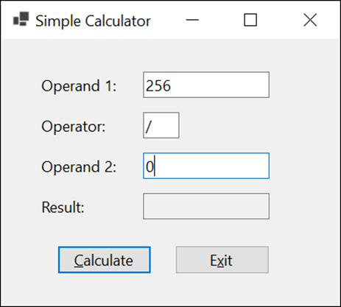
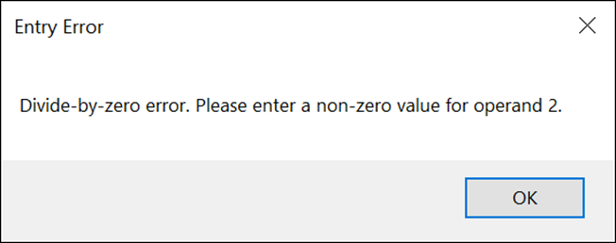
Extra 7-1 Add exception handling to the simple calculator
Add exception handling to the Simple Calculator form.

Slide 38
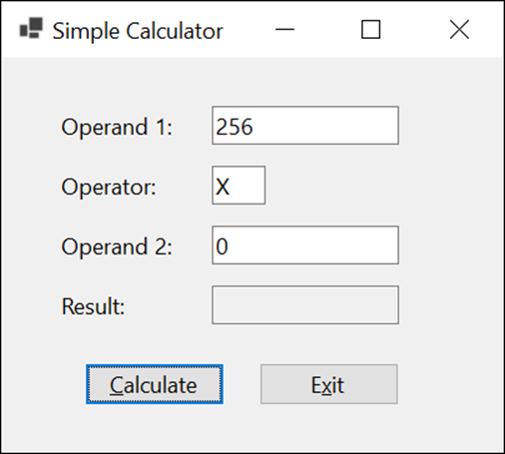
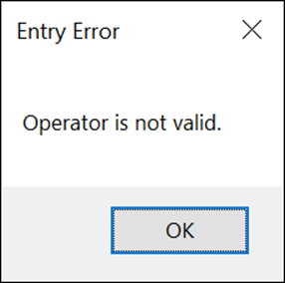
Extra 7-2 Add data validation to the simple calculator
Add data validation to the Simple Calculator form.

Slide 39
Objectives (part 1)
Applied
Given a form that uses text boxes to accept data from the user, write code that catches any exceptions that might occur.
Given a form that uses text boxes to accept data and the validation specifications for that data, write code that validates the user entries.
Use dialog boxes as needed within your applications.
Knowledge
Explain what an exception is and what it means for an exception to be thrown and handled.
Describe the Exception hierarchy and name two of its subclasses.
Describe the use of try-catch statements to catch specific exceptions as well as all exceptions.

Slide 40
Objectives (part 2)
Describe the use of the properties and methods of an exception object.
Describe the use of throw statements.
Describe the three types of data validation that you’re most likely to perform on a user entry.
Describe two ways that you can use generic validation methods in a method that validates all of the user entries for a form.

